Slide 1
KYTC District 6 “Great Eight” Incident Management Task Force
October 8, 2013

Slide 2
Introductions

Slide 3
Approval of Minutes
7/9/13 Meeting

Slide 4
Incident Review
I-71 NB @ MP 63.6 in Gallatin County 7/26/13
Tractor Trailer Rollover

Slide 5
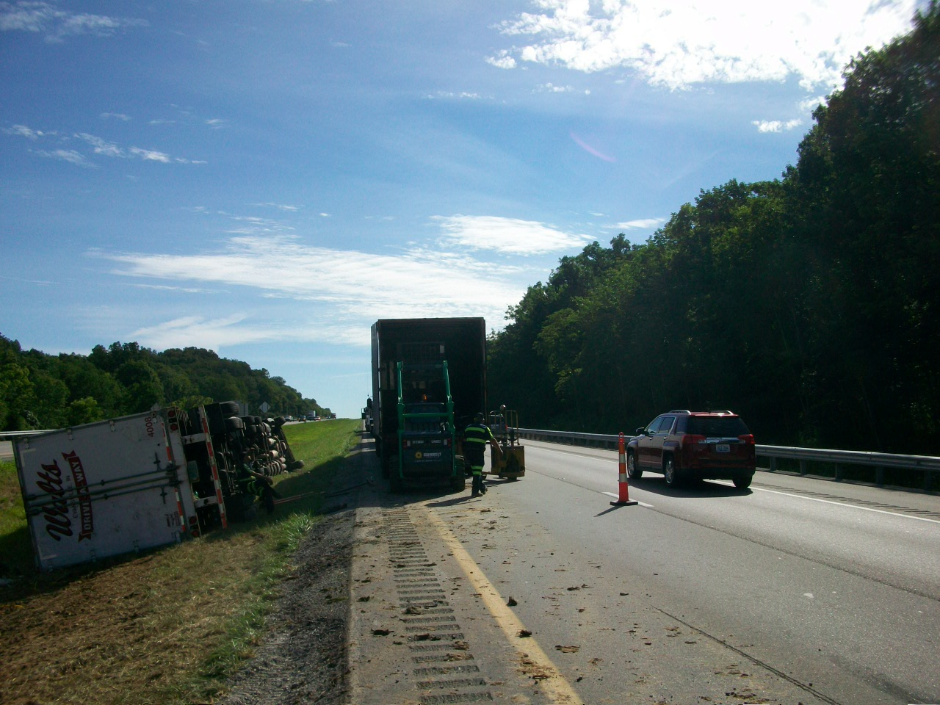

Slide 6
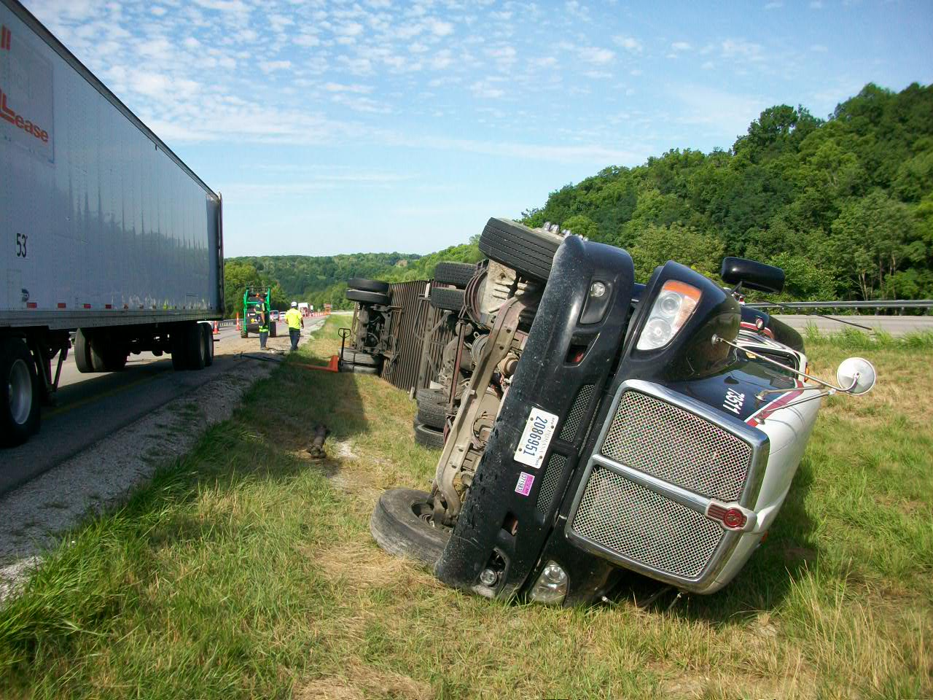

Slide 7
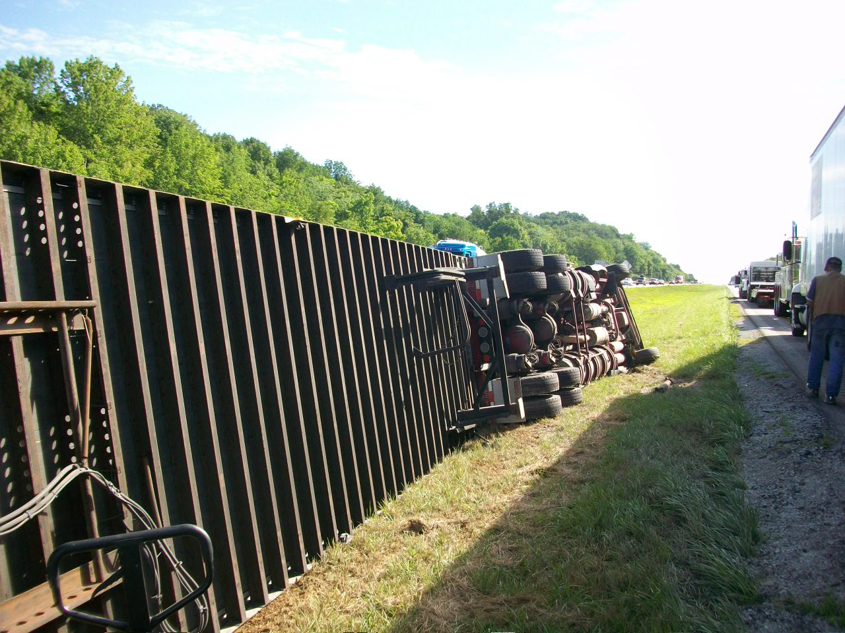

Slide 8
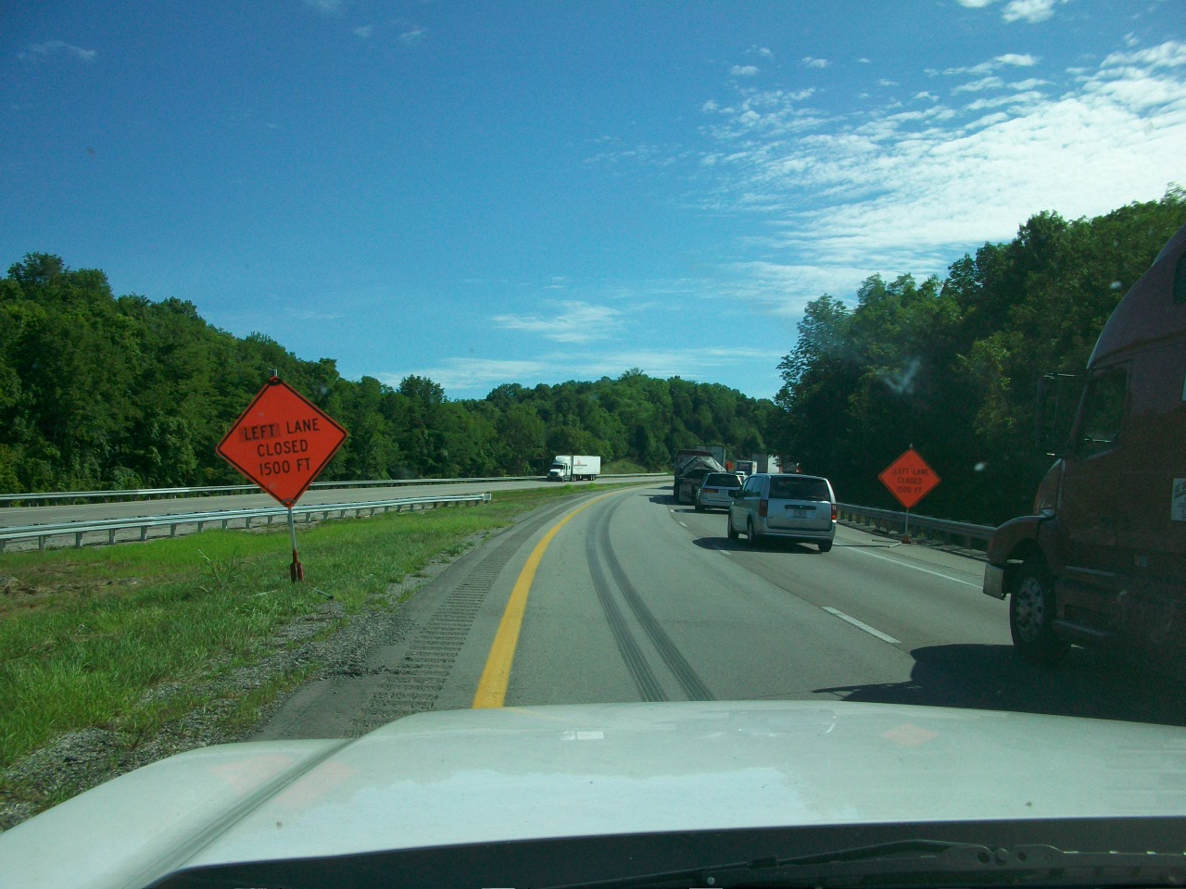

Slide 9
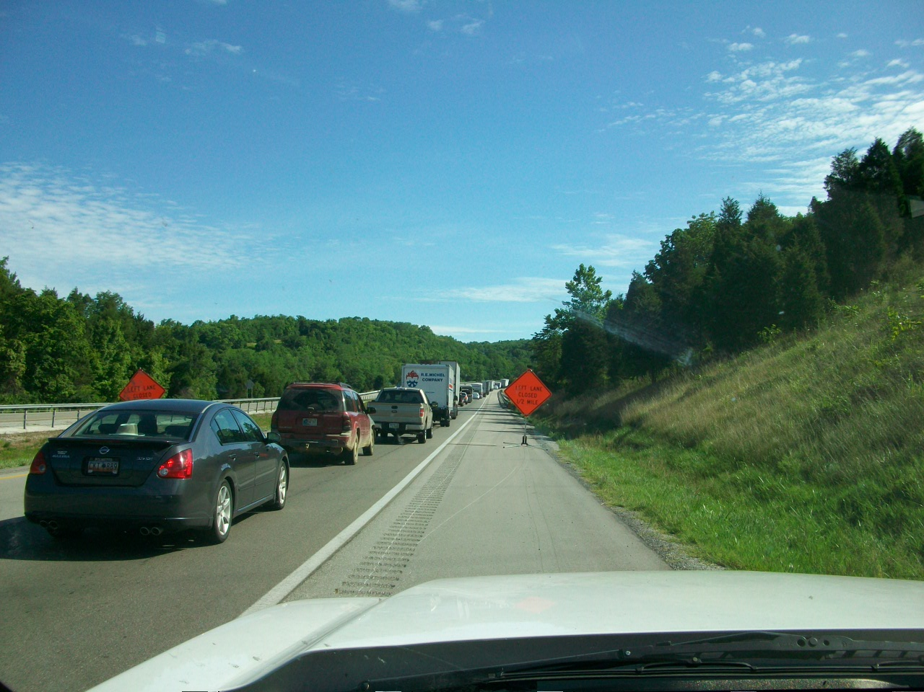

Slide 10
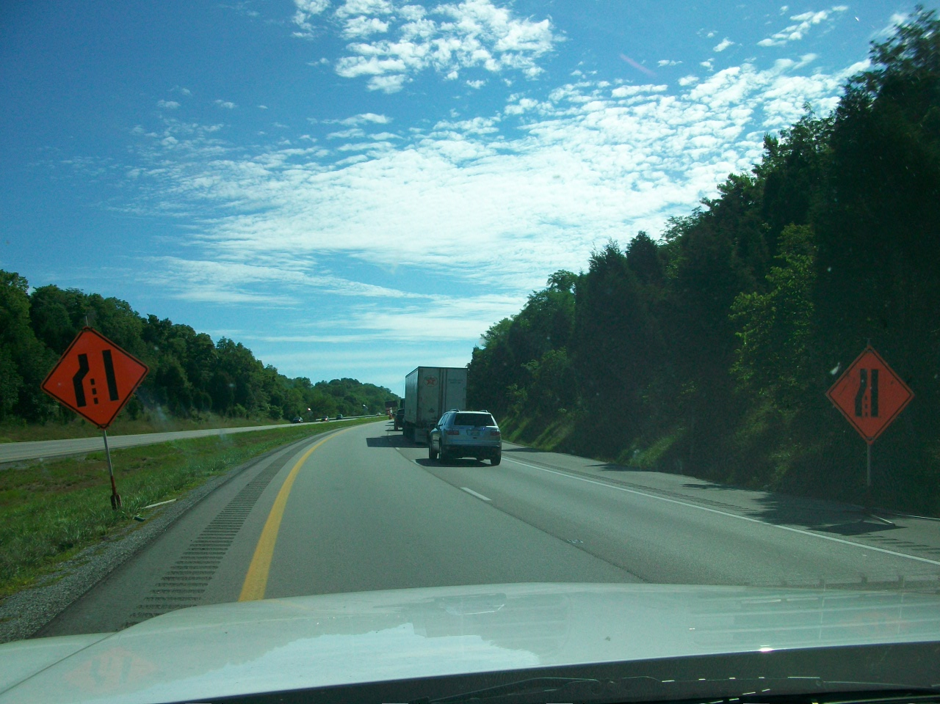

Slide 11
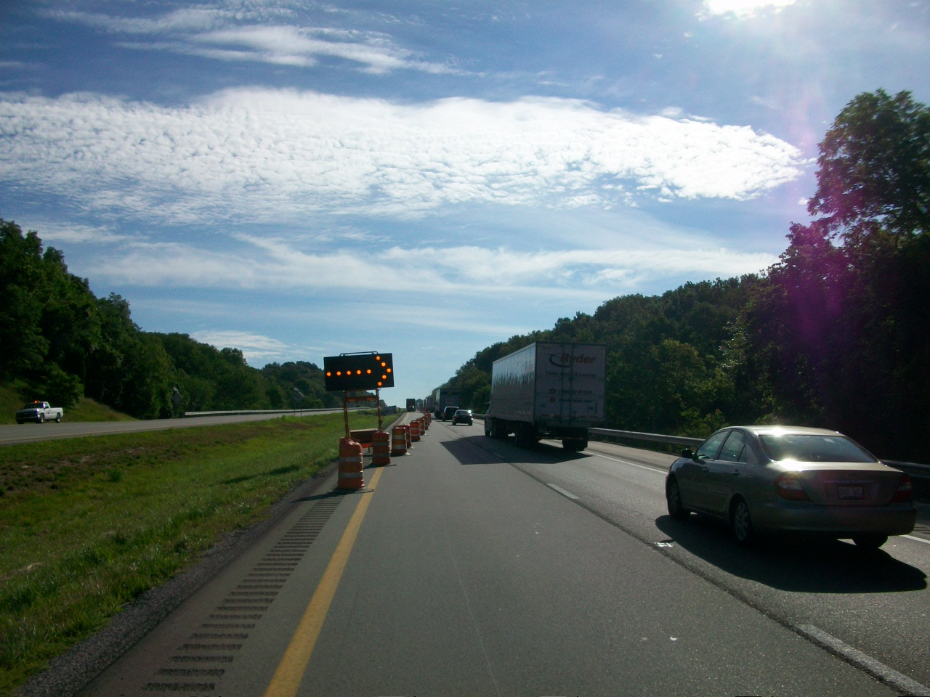

Slide 12
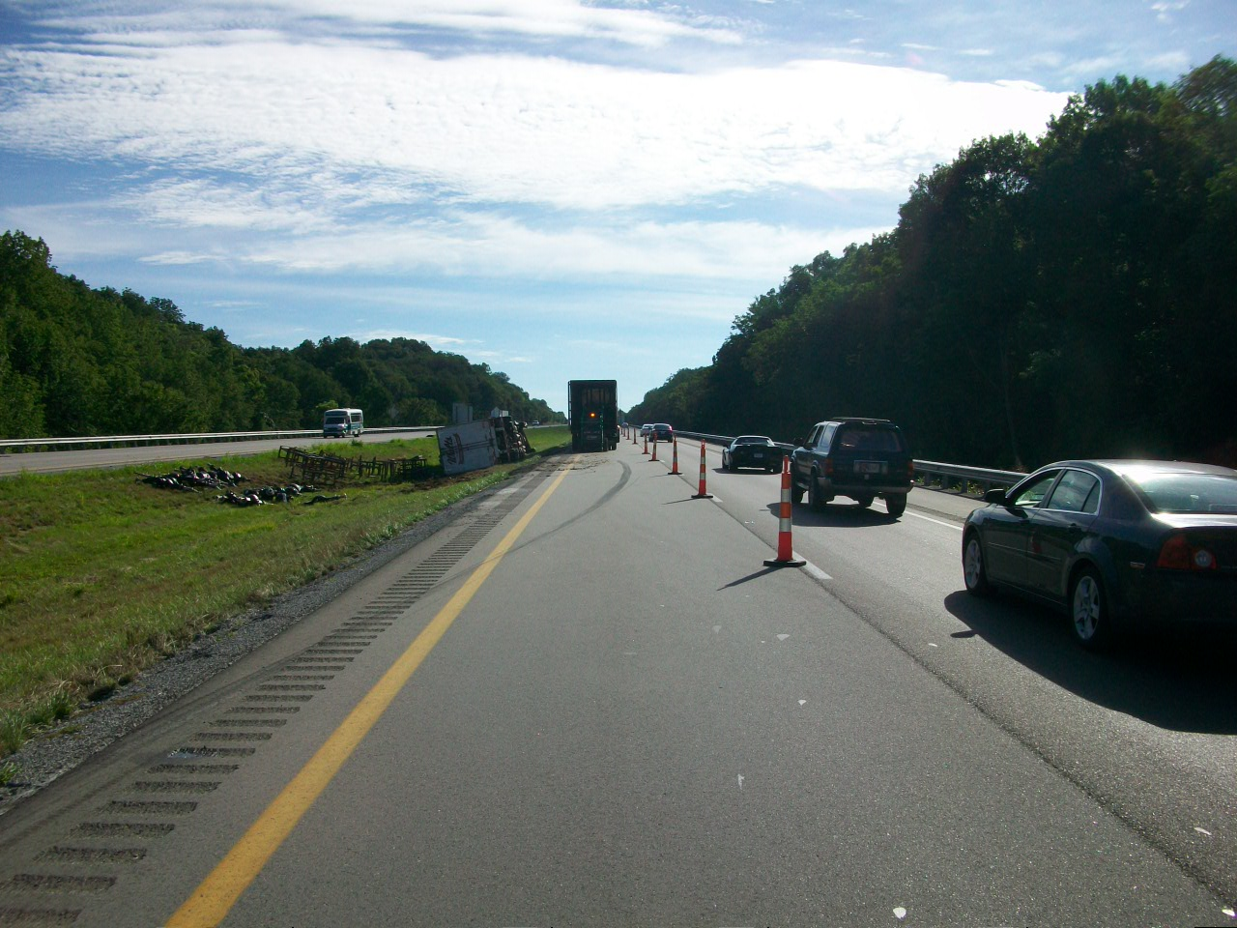

Slide 13
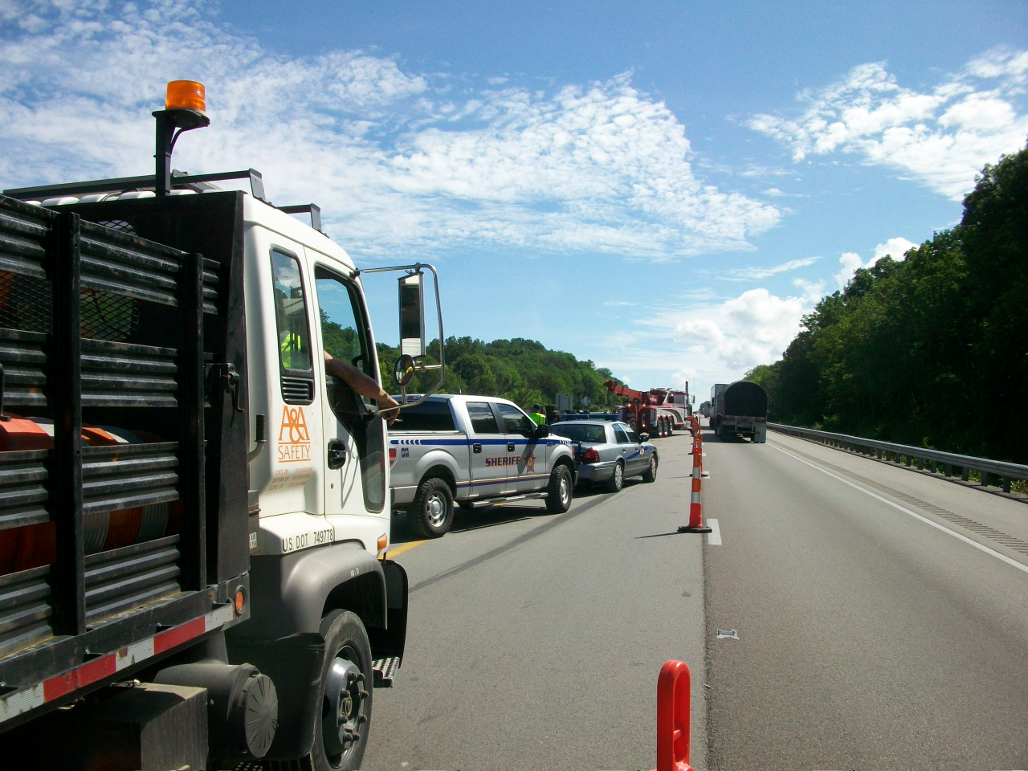

Slide 14
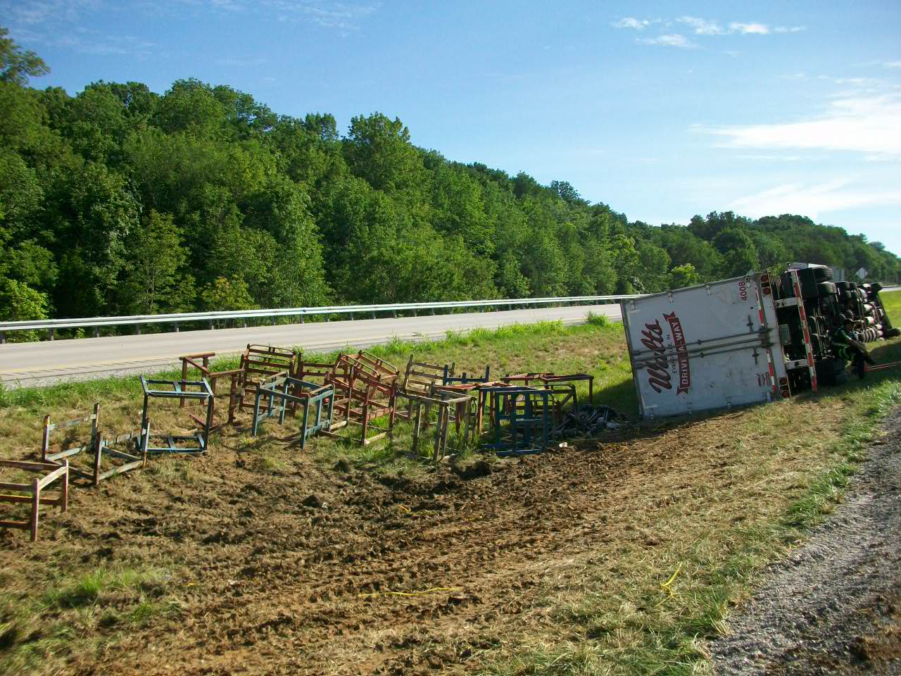

Slide 15
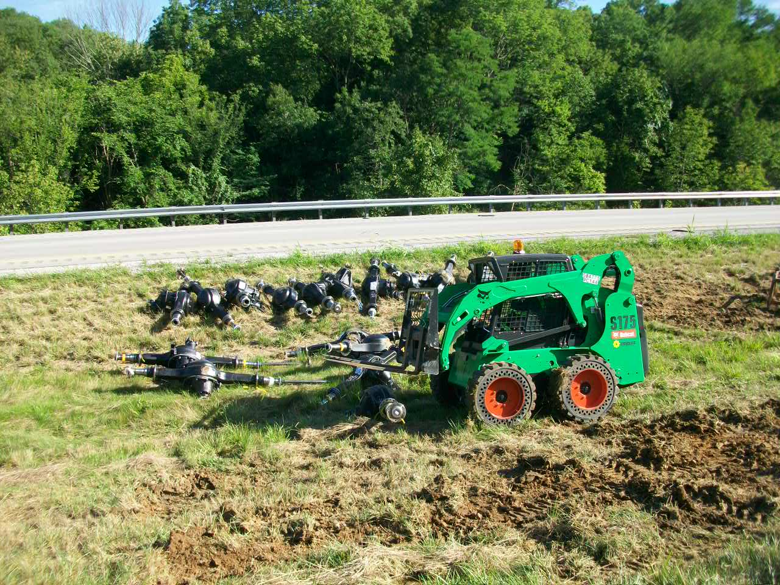

Slide 16
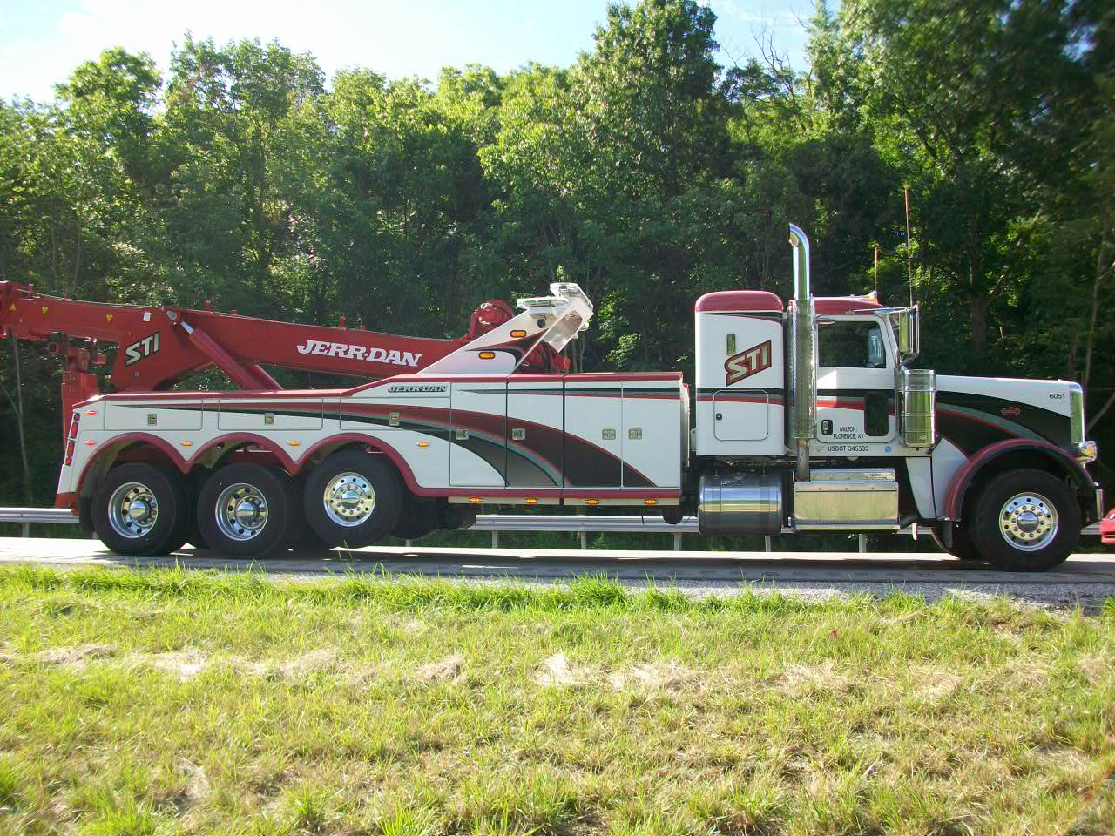

Slide 17
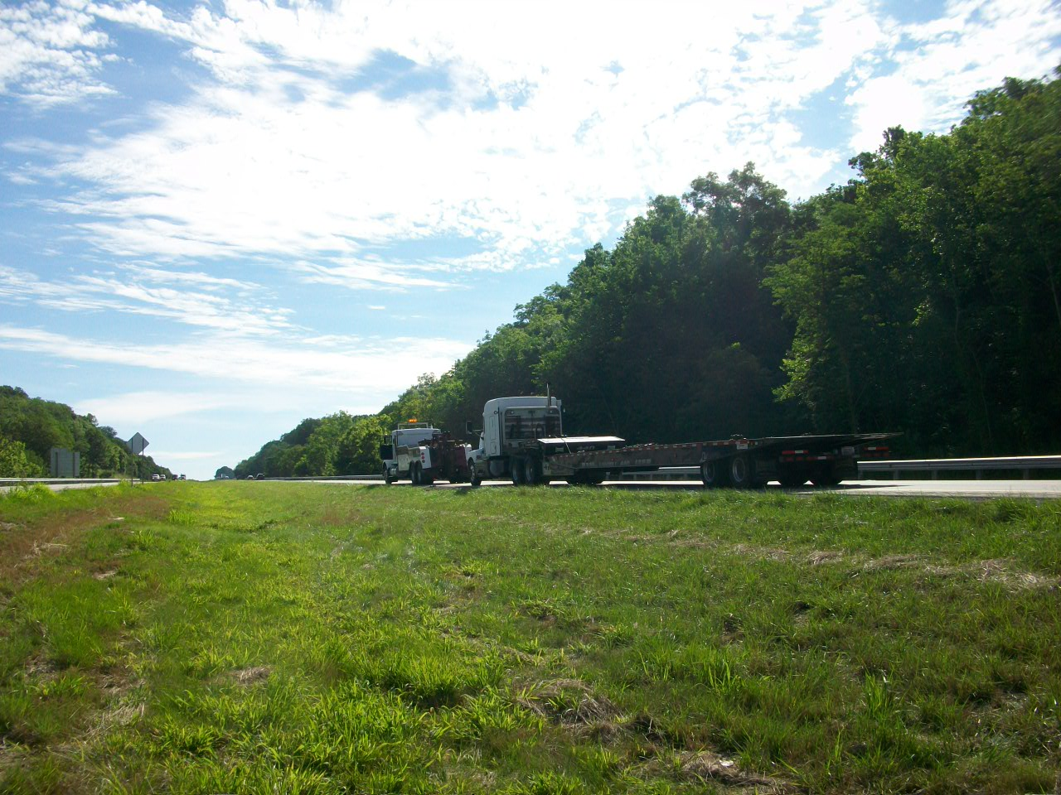

Slide 18
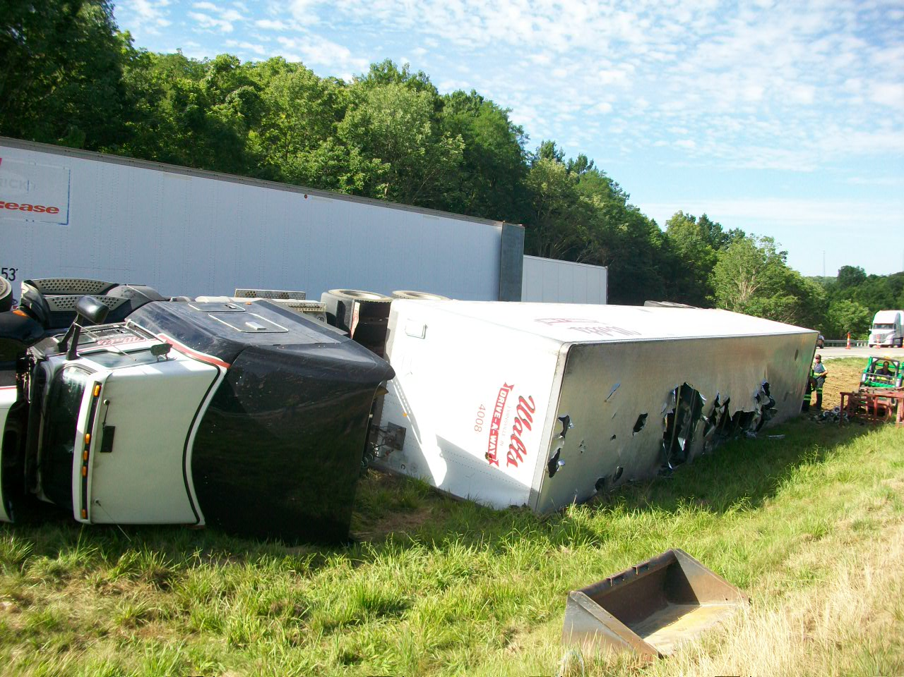

Slide 19
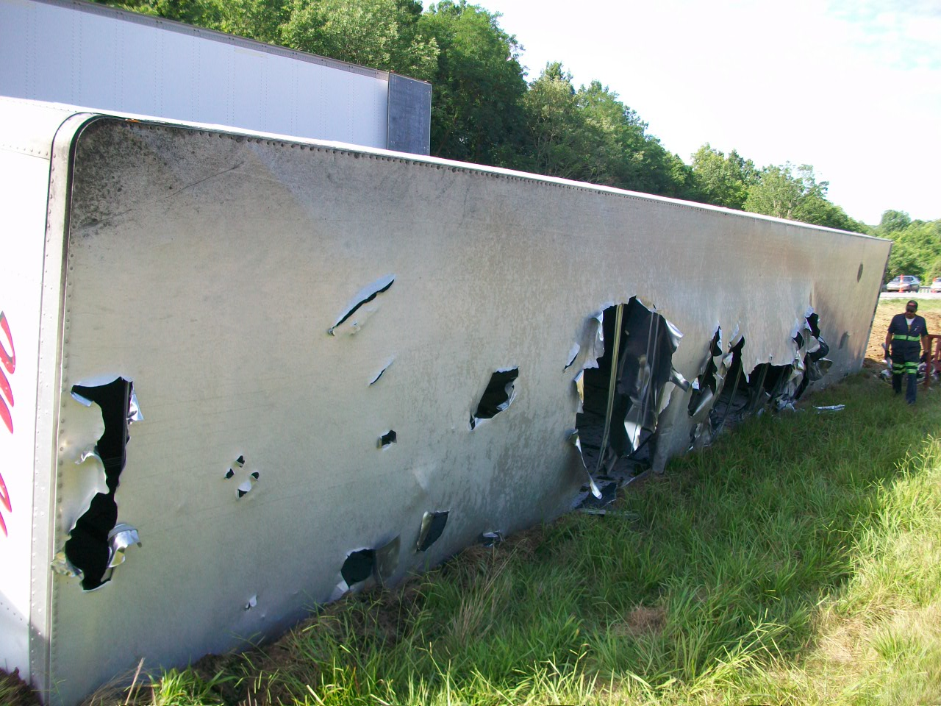

Slide 20
Incident Review
I-71 NB @ MP 59.3 in Gallatin County 7/26/13
Secondary Crash

Slide 21
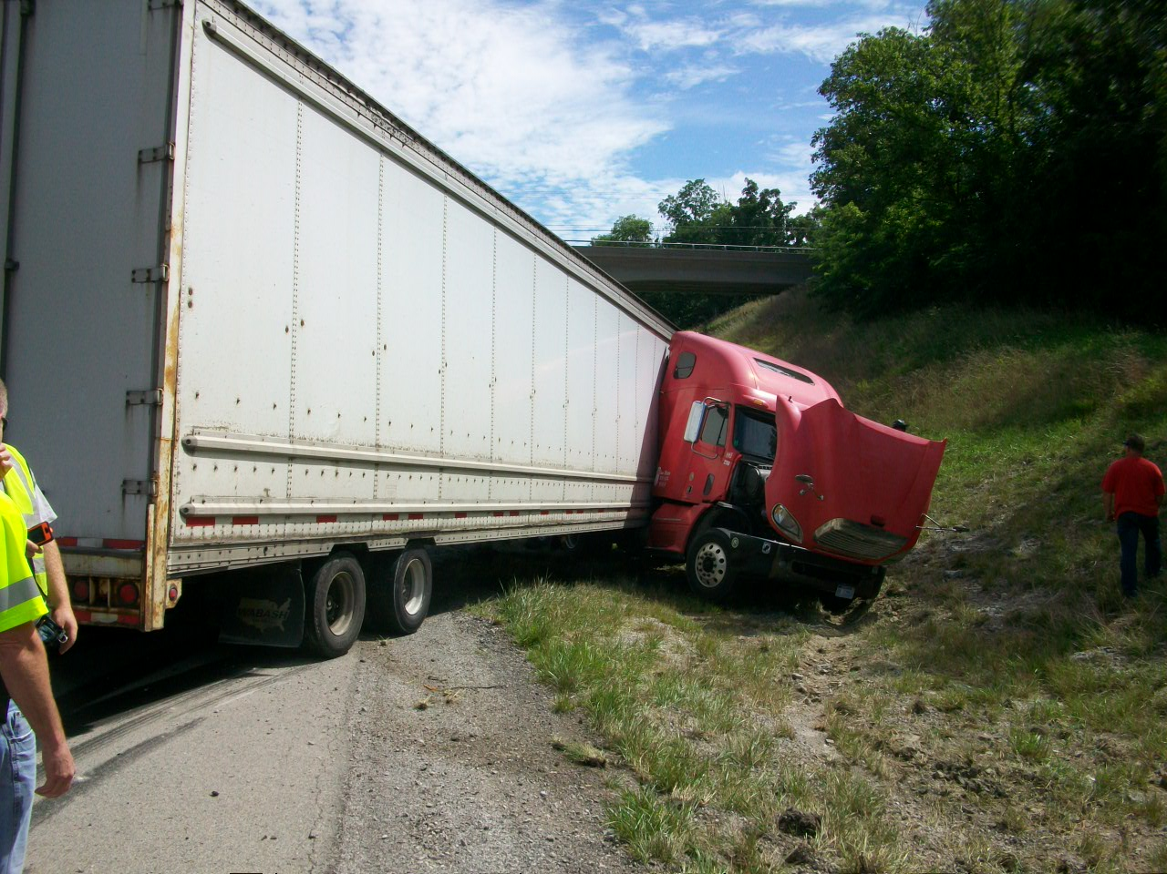

Slide 22
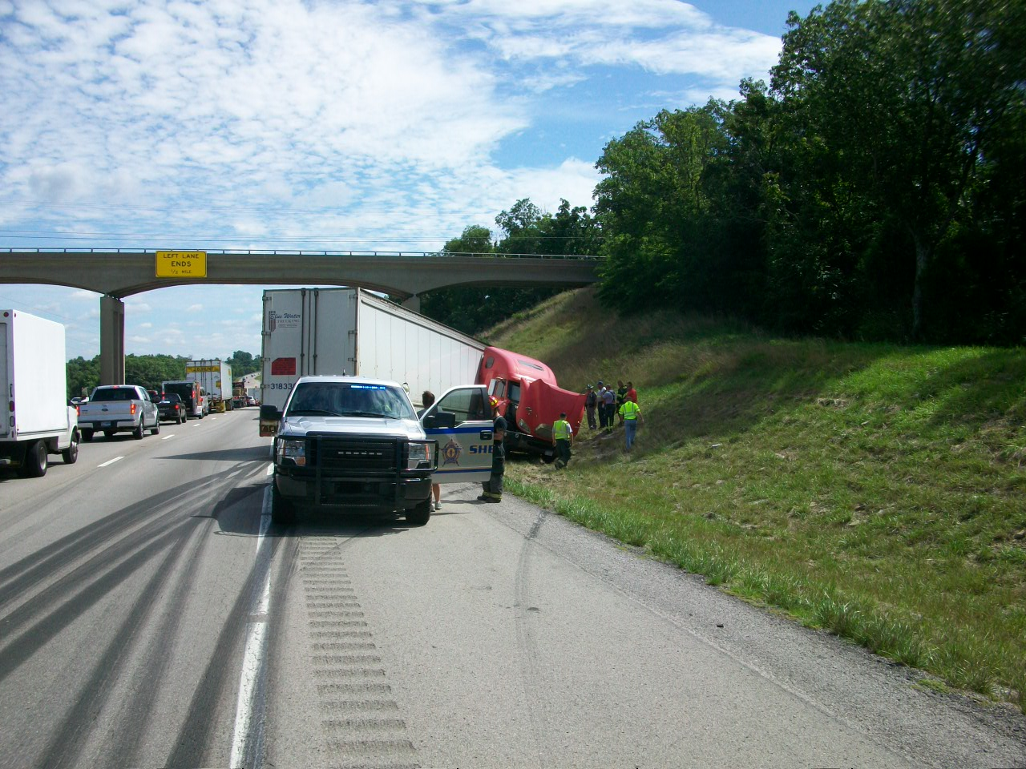

Slide 23
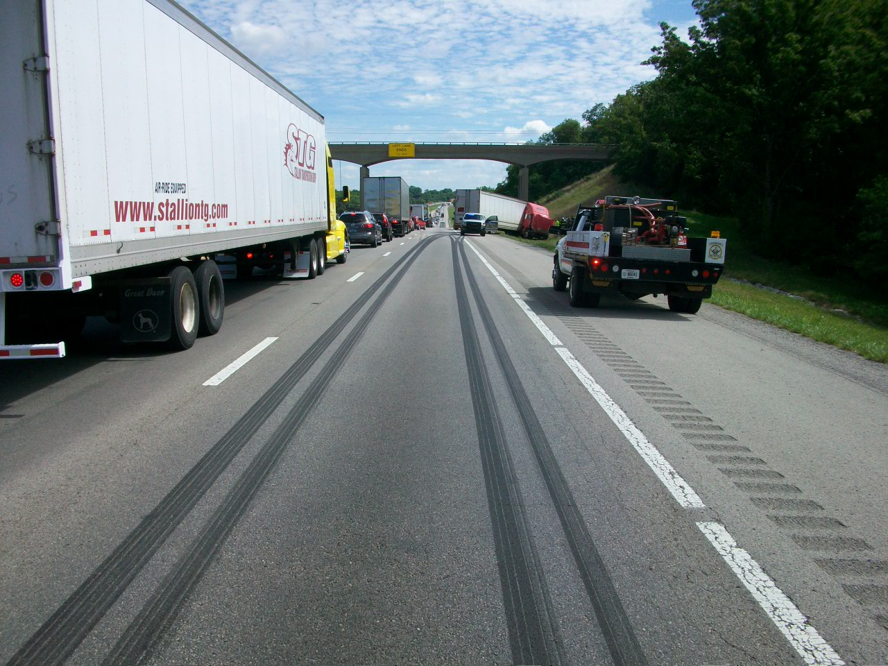

Slide 24
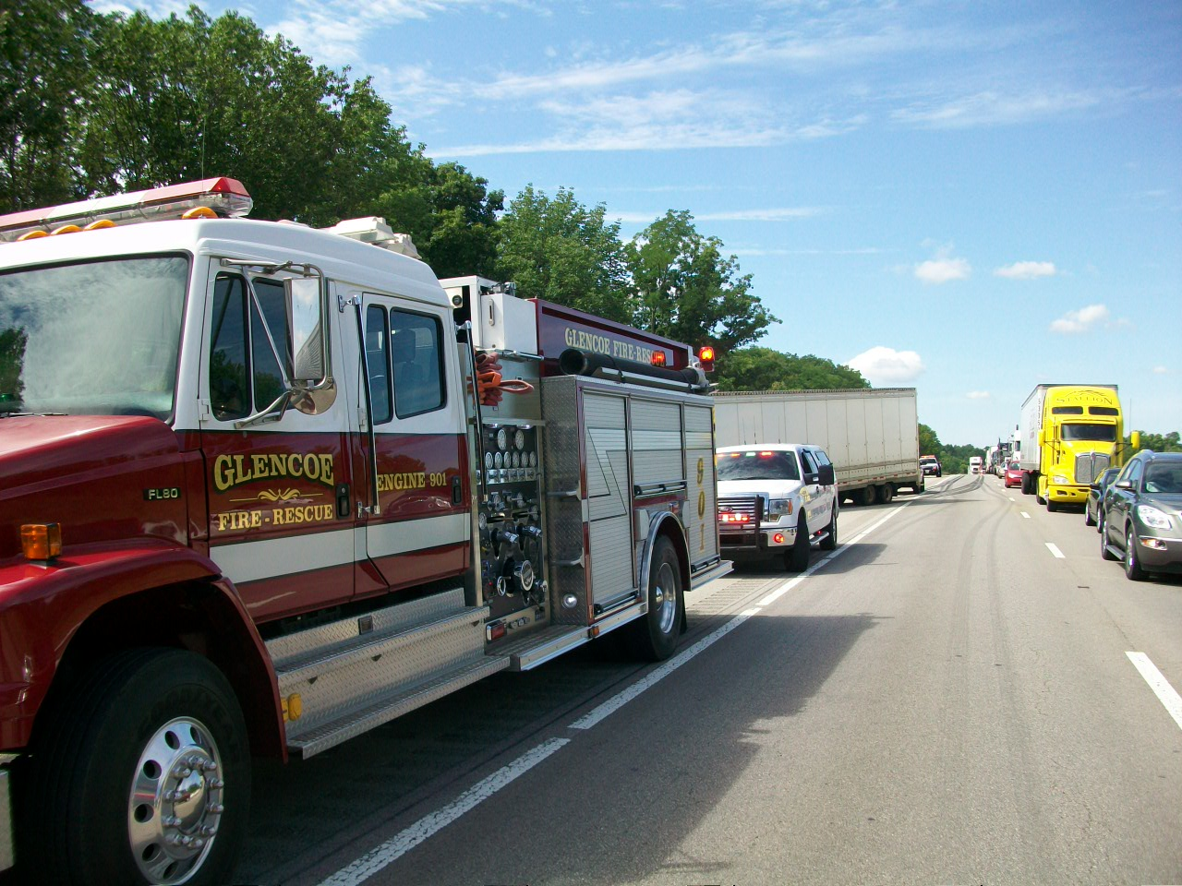

Slide 25
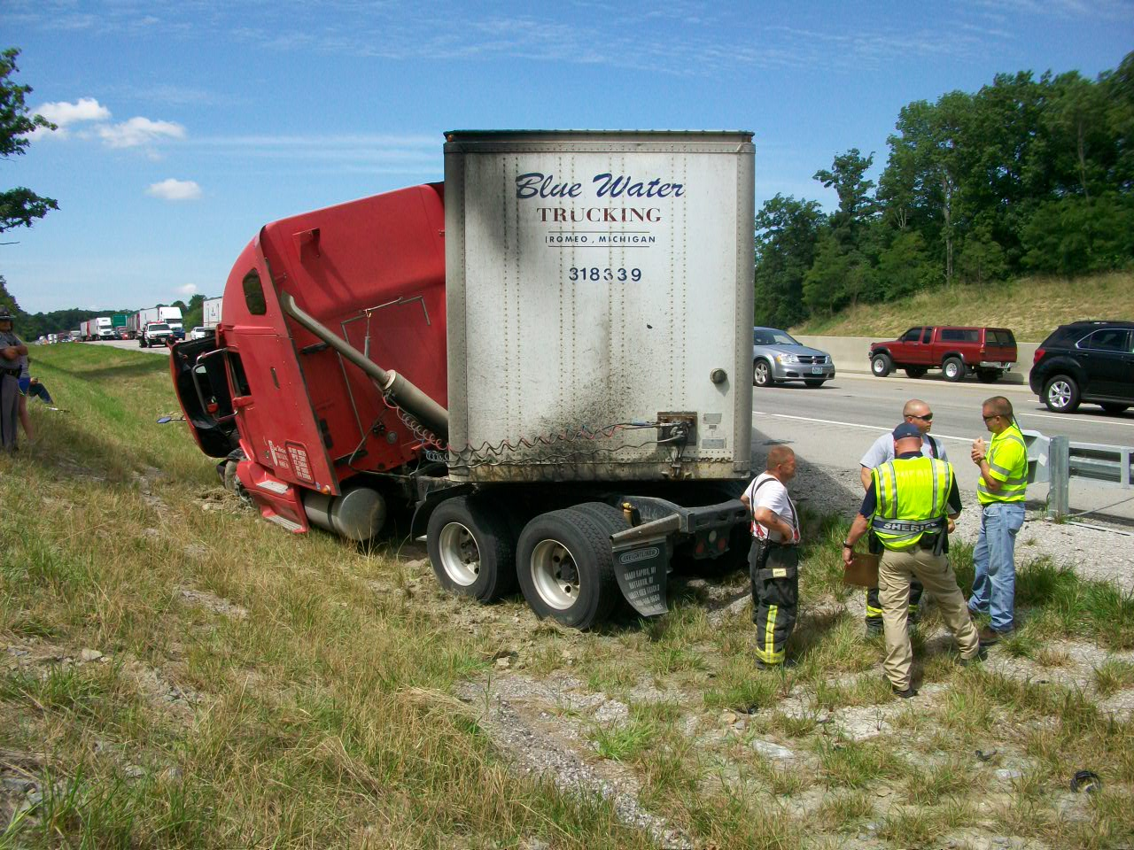

Slide 26
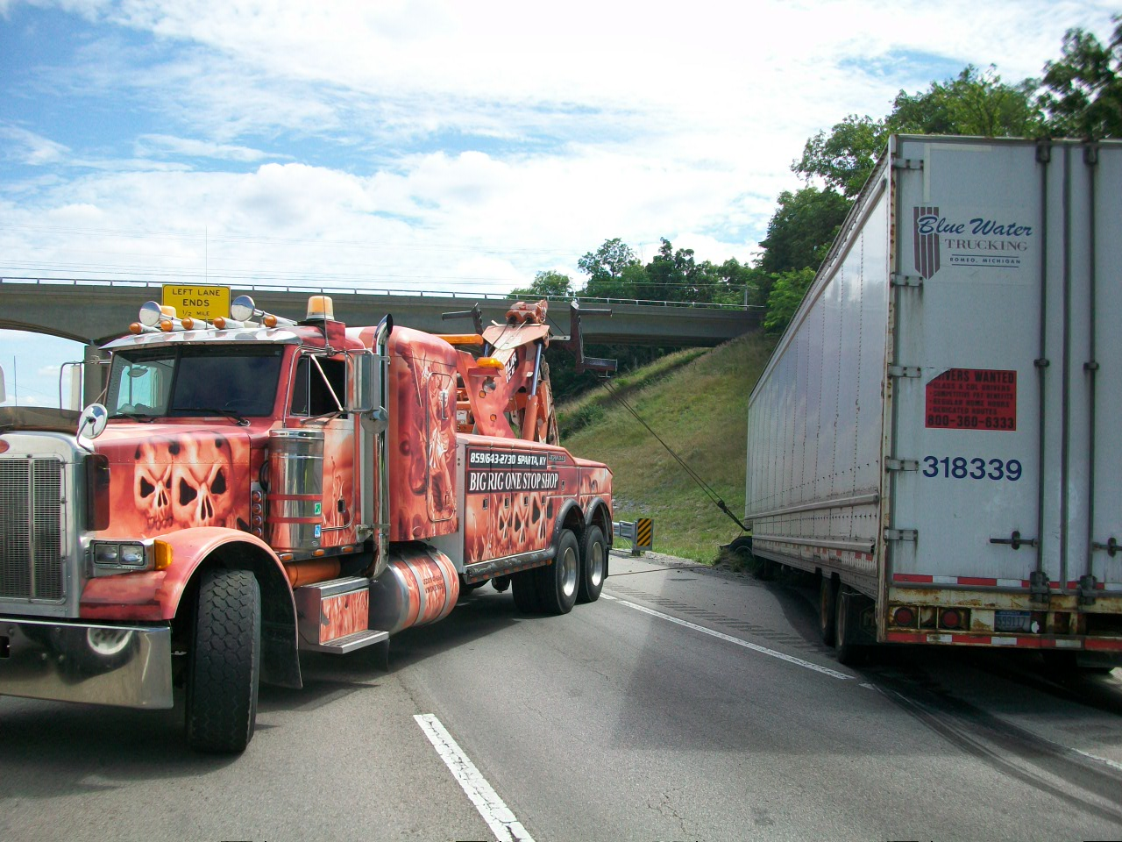

Slide 27
Incident Review
I-64 WB @ MP 37.8 in Shelby County 9/9/13
Initial Crash with Secondary Fatalities

Slide 28
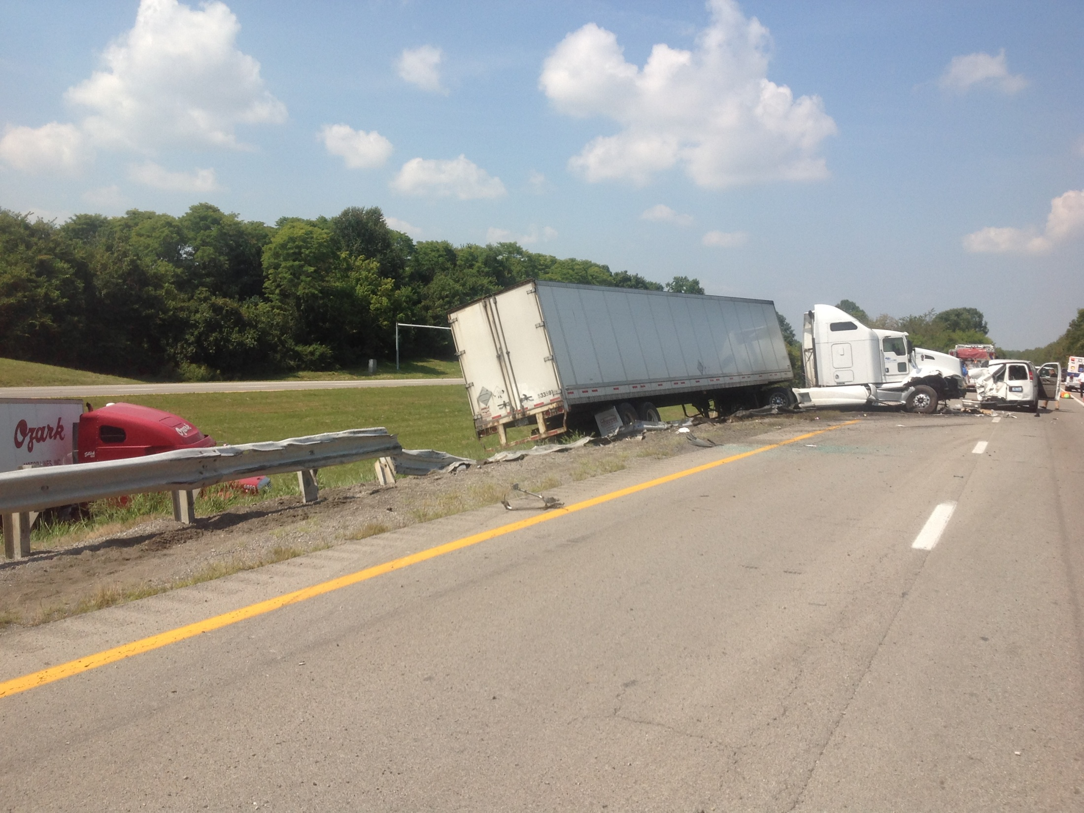

Slide 29
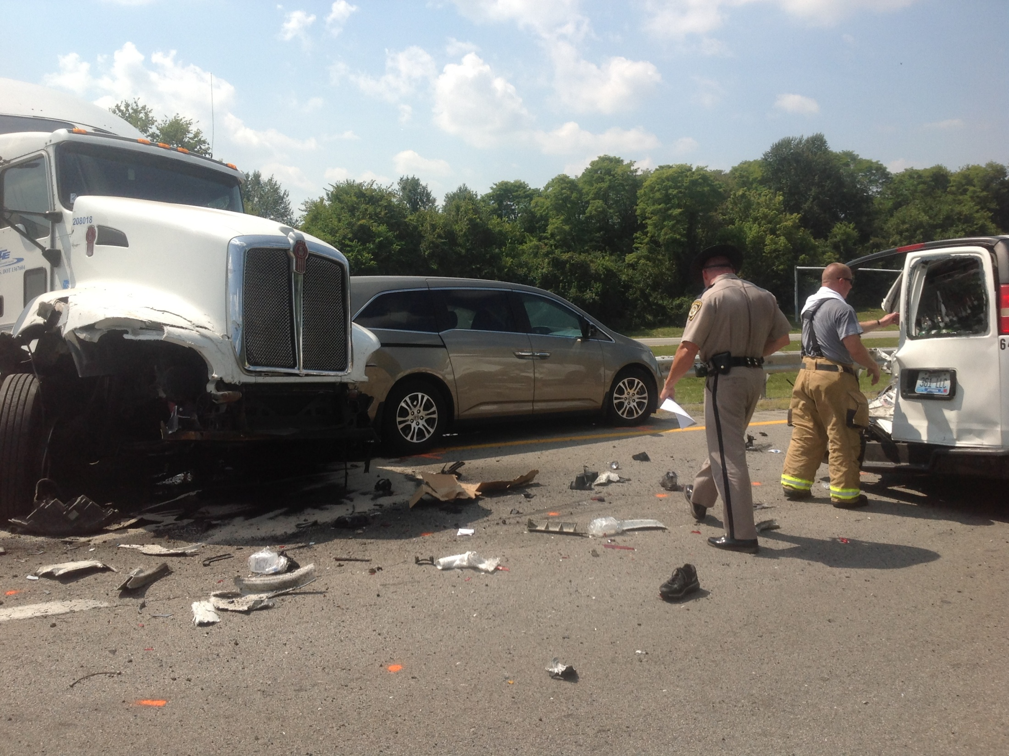

Slide 30
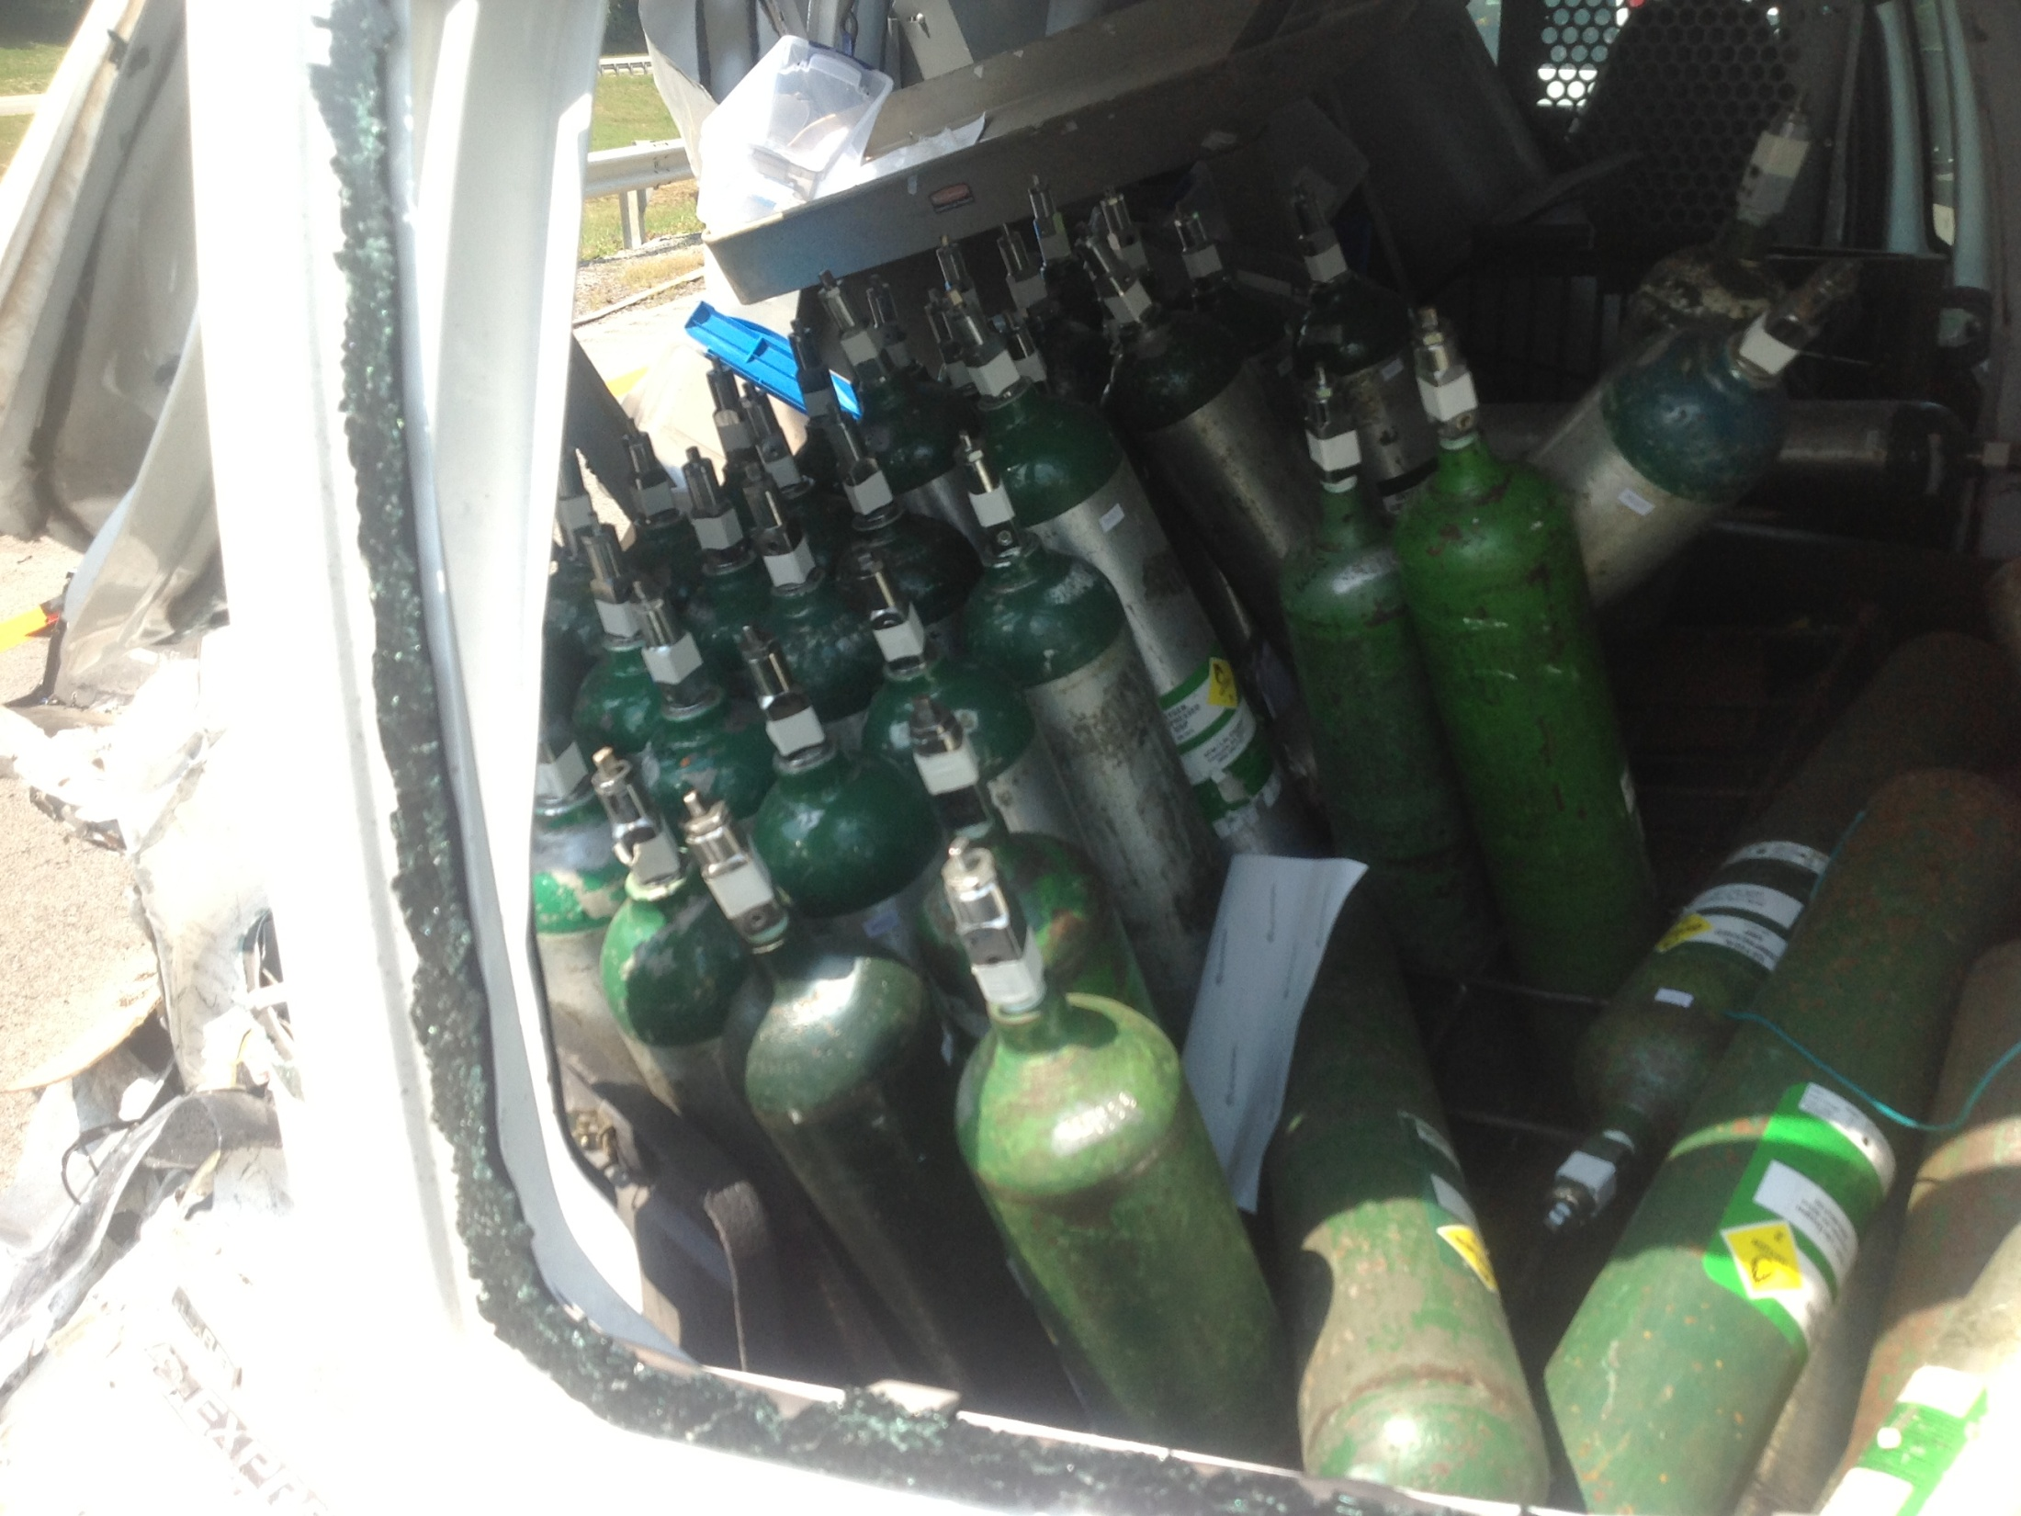

Slide 31
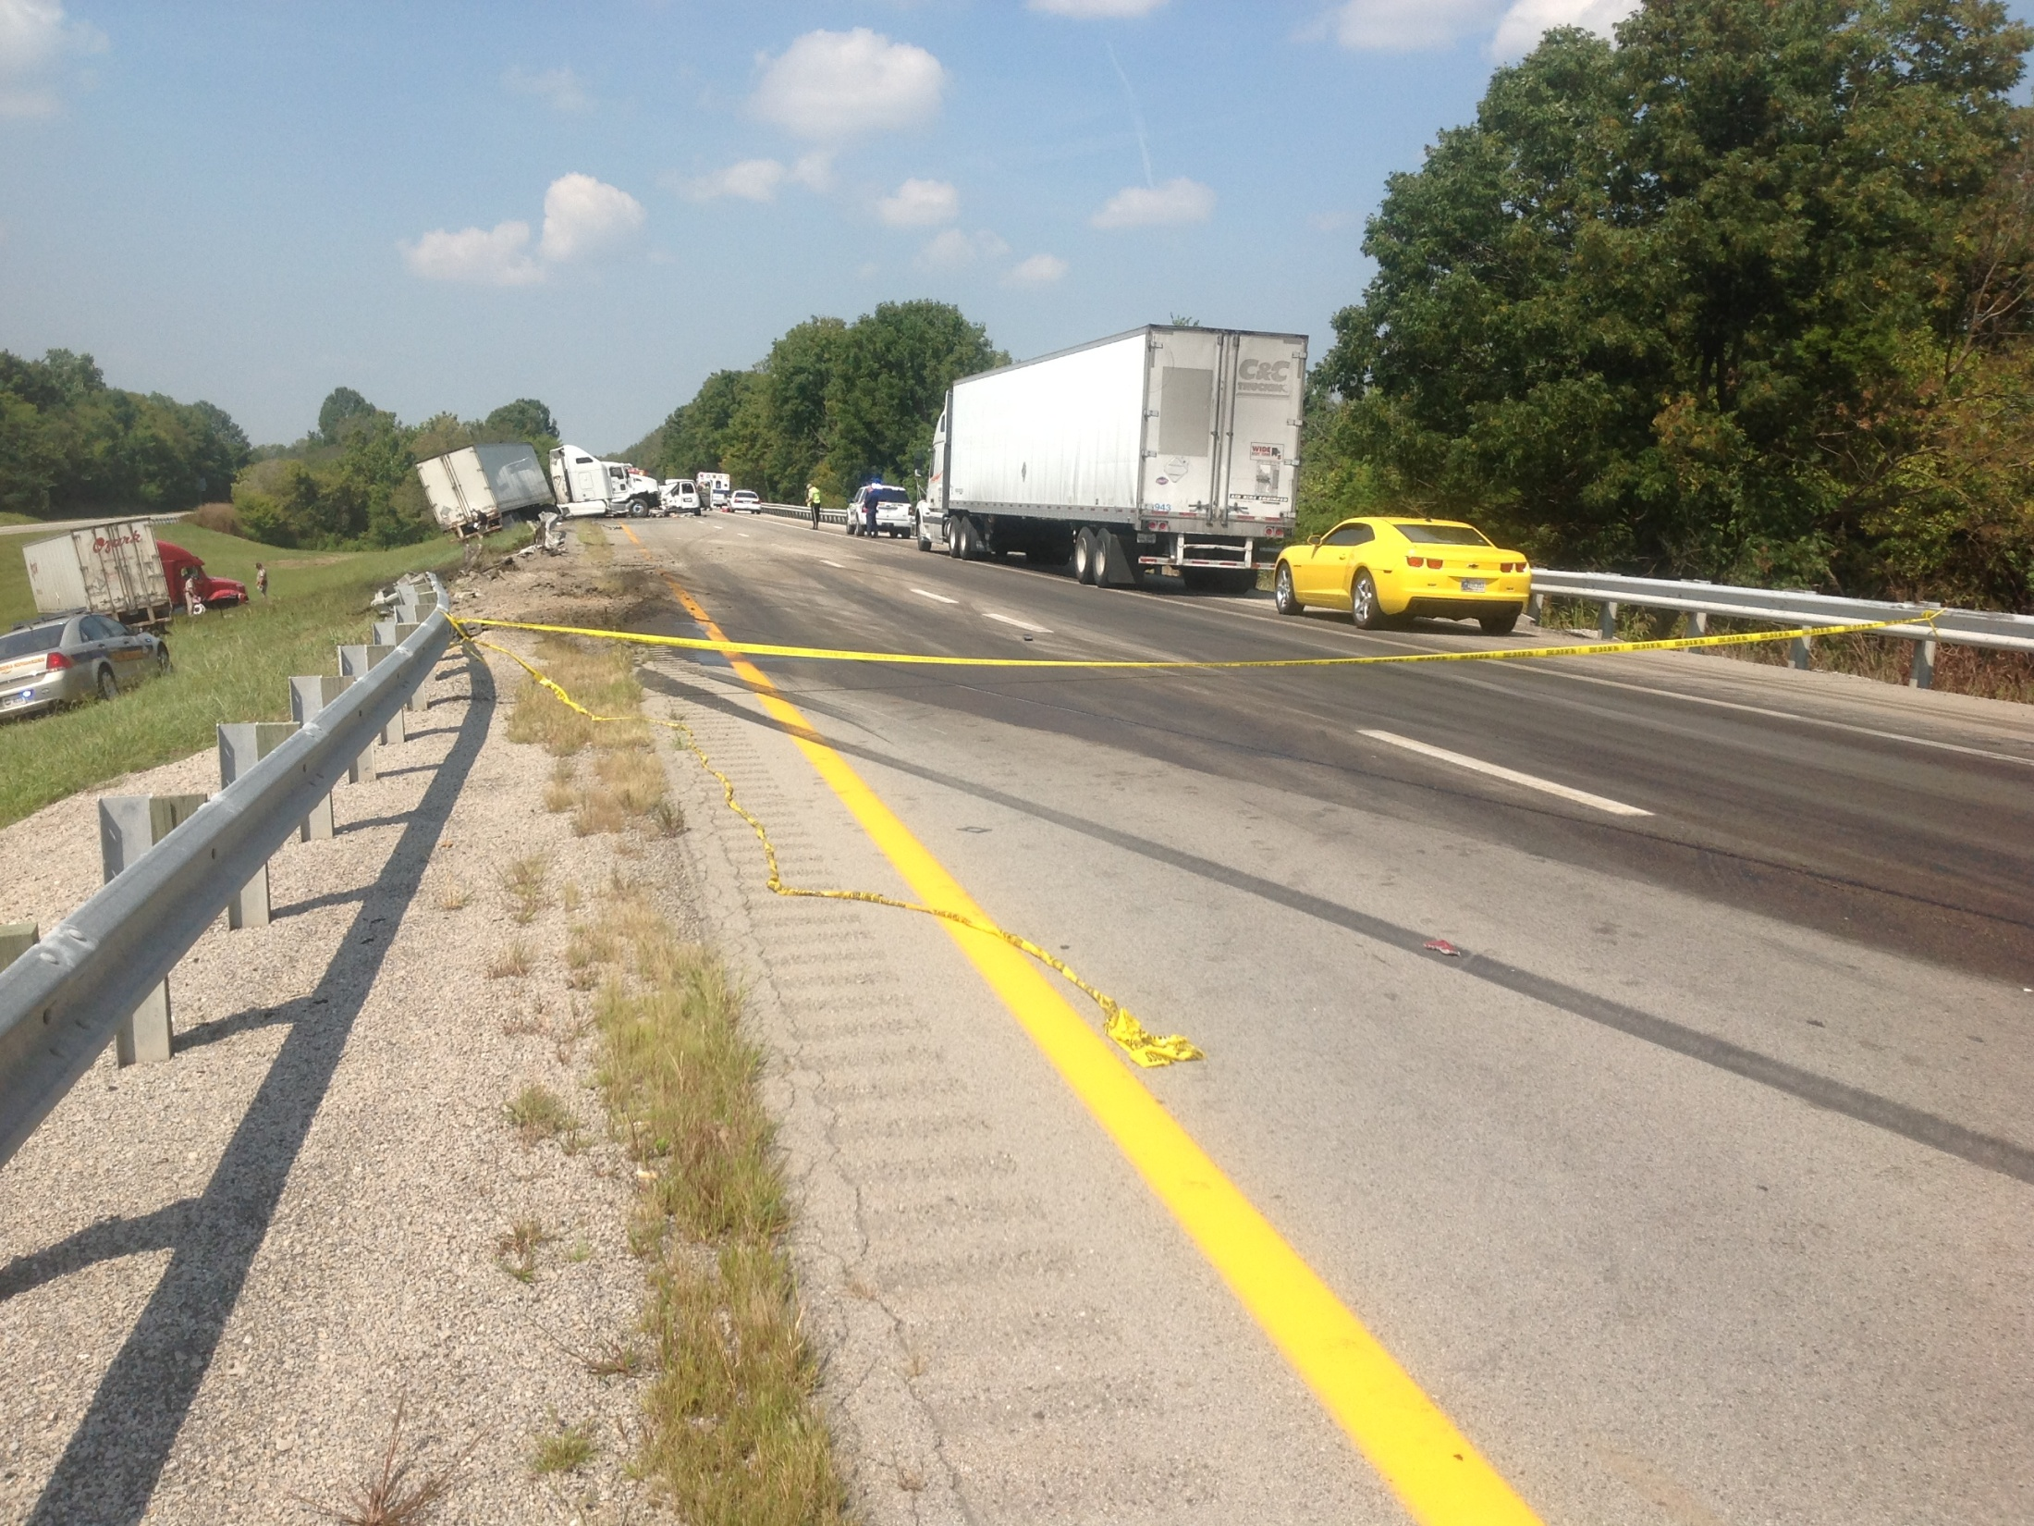

Slide 32
Crash Statistics
Quarterly Crash Statistics
KSP CRASH Database
Valerie Januski
District 6 Safety Officer

Slide 33
Southeast Counties

Slide 39
Southwest Counties

Slide 45
Construction Update

Slide 46
Other Business
Information Sharing

Slide 47
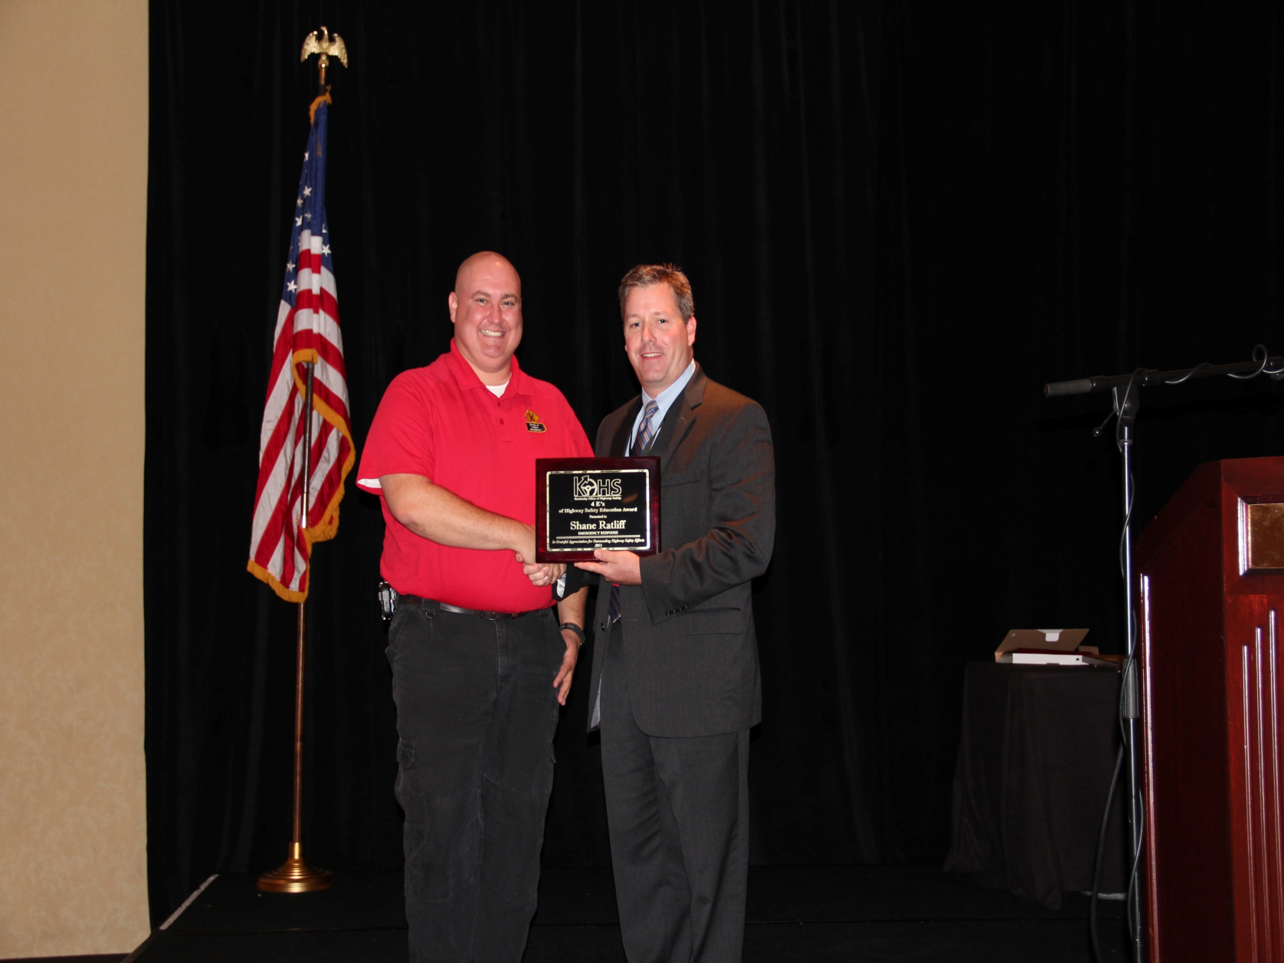

Slide 48
Incident Management Training Available
Kentucky Transportation Center

Slide 49
Adjourn
Next Meeting
Tuesday January 7, 2014
1:00 PM

